Slide 1
NEMDC Open Banking ReST Service Design v1.0
Jasper Thorburn and Jordan Bryan
December 2017

Slide 2
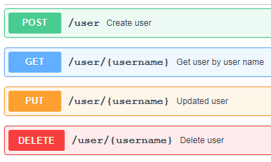
ReST Web Services
Representational State Transfer
POST (Create)
GET (Read)
PUT (Update)
DELETE (Delete)
GET /{AccountId}/balances
Why ReST?
Industry trend moving towards ReST
User friendly standards
Lightweight communication
Less complexity
API economy
Operations on a resource
Notes:
REST web services allow systems to manipulate resources using common operations. These resources may be a customer, or their accounts or an individual payment.
What each operation does.
Resources | Service Groups

Slide 3
ReST Service Overview
GET /nem/accounts/v1/{AccountId}/locks
Verb Base Path (inc. major version) Operation f
Expose directory structure-like URIs, comprising of base paths and operation paths.
Base paths = Service Groups
/nem/cabs/v1
/nem/payments/v1
/nem/accounts/v1
Operation Paths = Service Operations
/{AccountId}/locks
/{AccountId}/standing-orders
/{AccountId}/adhoc-payees
/{AccountId}/direct-debits
/{AccountId}/transactions
/{AccountId}/balances
ReST utilises HTTP responses.
HTTP 200 – OK HTTP 404 – Not Found
HTTP 201 – Created HTTP 500 – Internal Server Error
HTTP 400 – Bad Request HTTP 504 – Gateway Timeout
Basepath versions are the Service group version
Notes:
Major Versioning – Basepath
Minor Versioning – Schema Version | Service Gateway
Grouping by resource (up for debate) we are able to separate.
With RSA 9.6 we could have individual and import common components?
HTTP Error Responses later.
Talk through HTTP Responses.

Slide 4
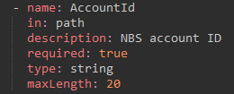
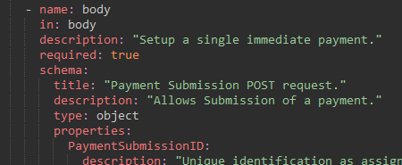
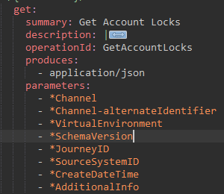
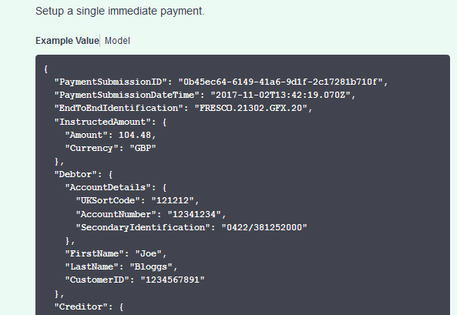
Open Banking Operation Examples
GET Account Locks:
Service header
Parameters - Path| Query String
POST Electronic Payment
Body (unlike GET)
Complex request, simple response
Notes:
Service header per swagger spec. Not currently imported. Future improvement.
GET - Parameters in either path or query string
POST – Parameters in the body.

Slide 5
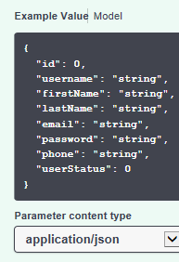
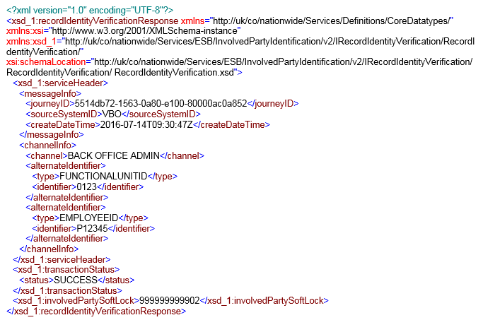
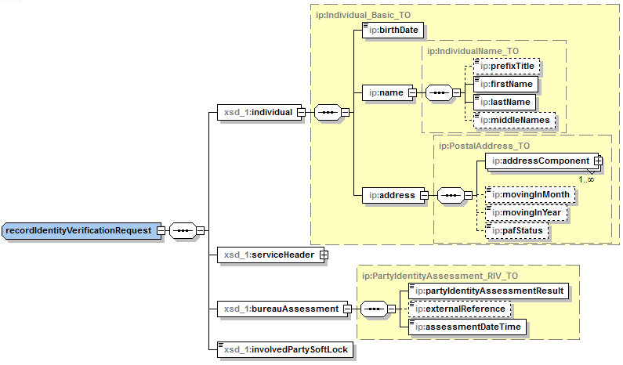

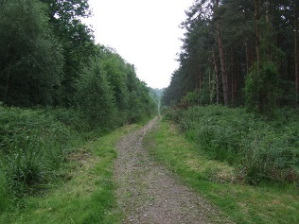


ReST Service Modelling
SOAP (other releases)
RSA
WSDL (XML)
XSD (XML)
XML Spy
Sample Messages (XML)
Direct Design
ReST (open banking)
Swagger
Service Interface (JSON / YAML)
Data Model (JSON / YAML)
Example Messages (JSON / YAML)
Service Groups
Grouped by base path rather than function
Multiple operations per swagger
Notes:
1. Different between soap and rest -> RSA -> swagger.
2. Apply direct design. Build up from requirements, rather than IFW starting point. Look to relate back to IFW when possible.
3. Swagger is versionable component.

Slide 6
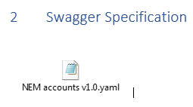
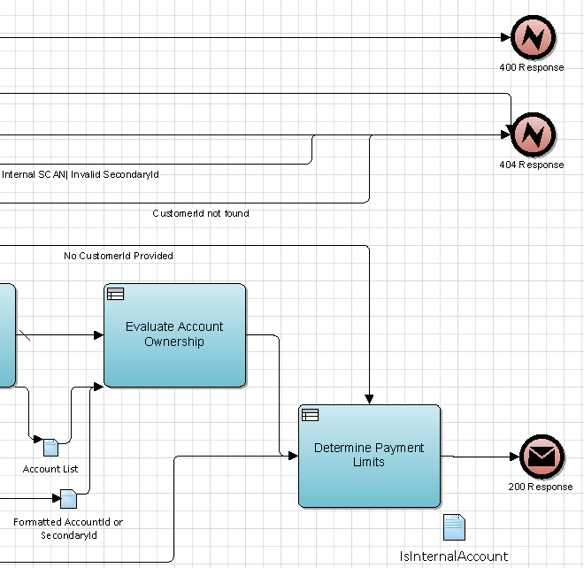
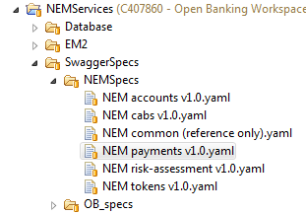

ReSTful Service Design – Documentation
Functional Specs:
Lightweight specs
MVP for service creation
Include Swagger Spec
No duplicate information.
OB Specs and Template Sharepoint Link
Swagger Spec
Limitations (subtyping | polymorphism not yet implemented)
OPM II’s:.
Guiding discussion and presenting.
Complex services where optional calls and alternate paths.
Alternative potential response messages.
Sequence Diagrams:
Currently used for SOAP services.
Do not allow for different HTTP error response types.
Notes:
Func Specs, tuned to build team requirements.
Swagger Interface -> FS supporting doc.
FS allows swagger to become point in time (for releases).
Not currently implemented Subtyping or polymorphism.
Store and version control swagger in RTC via RSA.
Sprints -> OPMs to guide discussion and flush out use cases.

Slide 7
HTTP Responses - Categorisation
HTTP Code | Description | Type | Returned By |  | Swagger Presence | Defined at…
 |  |  | Service | Datapower
200 | OK | Success | ✓ | ✗ | Only when used by a service operation. | Service level
201 | Created | Success | ✓ | ✗
202 | Accepted | Success | ✓ | ✗
304 | Not Modified | Success | ✓ | ✗
409 | Conflict | Error | ✓ | ✗ | Only when used by a service operation. | Swagger level
400 | Bad Request | Error | ✓ | ✓ | Present in all swaggers. | Swagger level
404 | Not Found | Error | ✓ | ✓
500 | Internal Server Error | Error | ✓ | ✓
503 | Service Unavailable | Error | ✓ | ✓
504 | Gateway Timeout | Error | ✓ | ✓
401 | Unauthorised | Error | ✗ | ✓ | Present in all swaggers. | Swagger level
403 | Forbidden | Error | ✗ | ✓
405 | Method Not Allowed | Error | ✗ | ✓
406 | Not Acceptable | Error | ✗ | ✓
429 | Too Many Requests | Error | ✗ | ✓
TransactionStatus is never returned by Datapower responses. It is only returned by service error responses.
Notes:
Summarise categories and differences between.
Example of each category
Need to represent datapower responses as consumers must code logic for handling.

Slide 8
Any questions?
?

Slide 9
Appendix
Overview:
https://www.ibm.com/developerworks/library/ws-restful/index.html/
Basic Design Principles:
Use HTTP methods explicitly -> GET(read)/PUT(Update/Replace)/POST(Create)/DELETE
http://www.restapitutorial.com/lessons/httpmethods.html

Slide 10
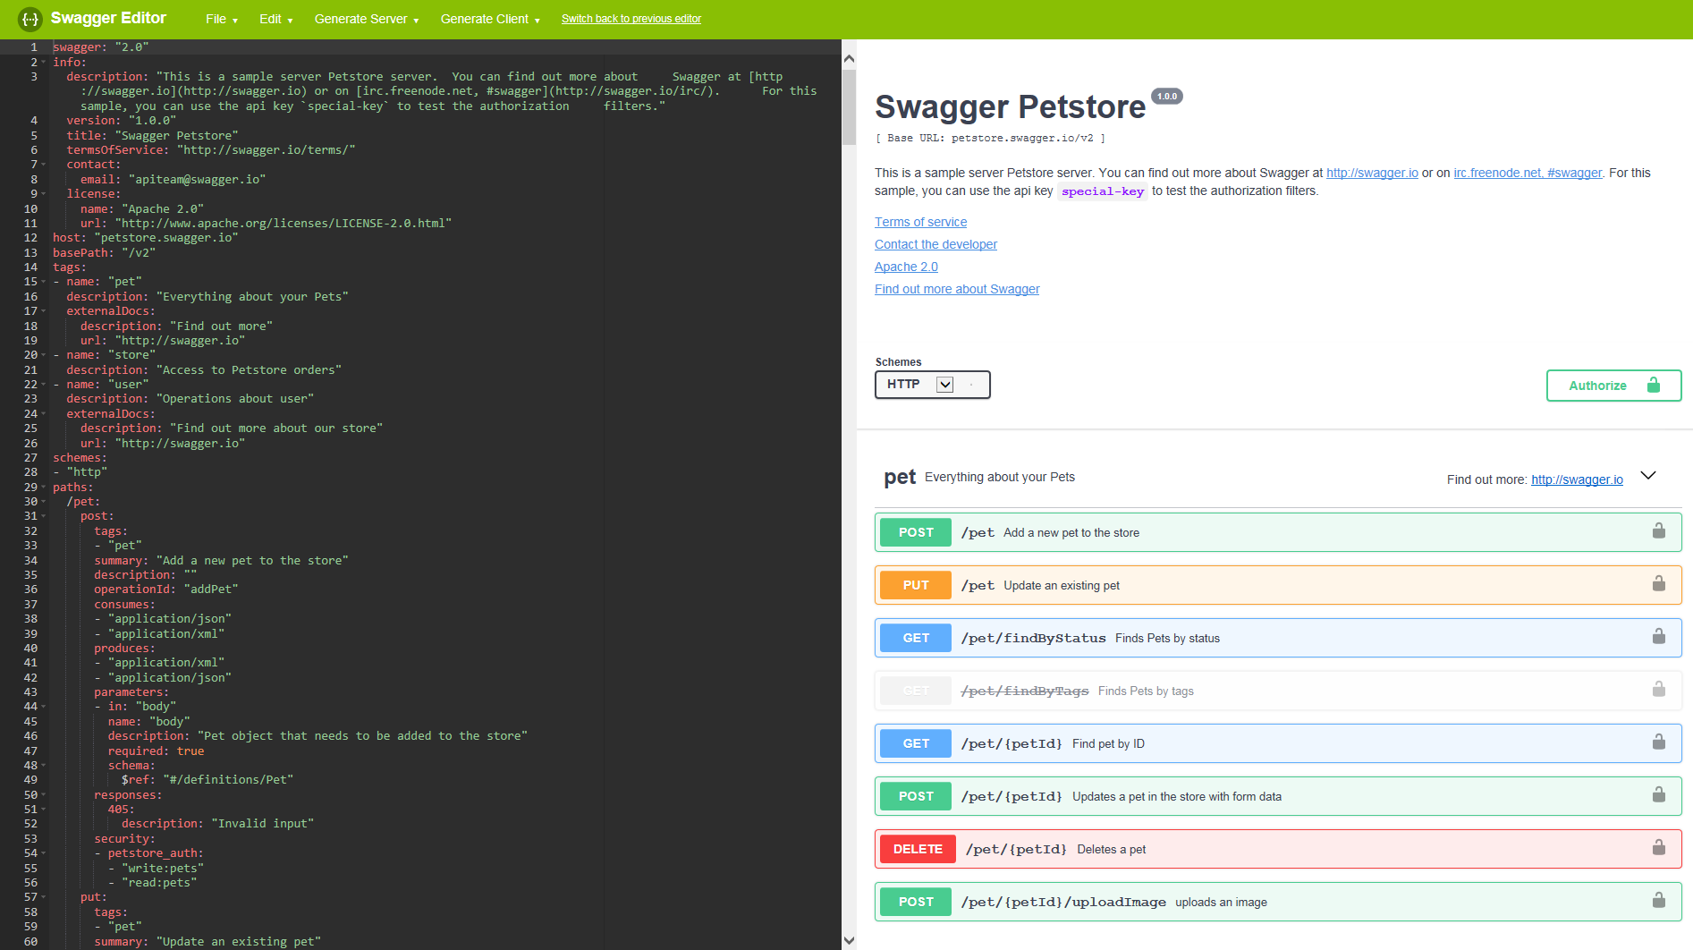
Swagger Editor

Slide 11
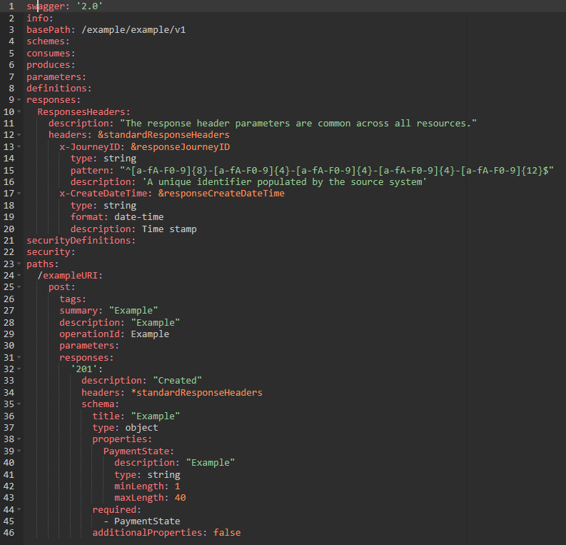
Appendix HTTP Responses – Categorisation Example
HTTP Code | Description | Type | Returned By |  | Swagger Presence | Defined at…
 |  |  | Service | Datapower
200 | OK | Success | ✓ | ✗ | Only when used by a service operation. | Service level
201 | Created | Success | ✓ | ✗
202 | Accepted | Success | ✓ | ✗
304 | Not Modified | Success | ✓ | ✗
No TransactionStatus
Response headers Included
Included and defined at service level

Slide 12
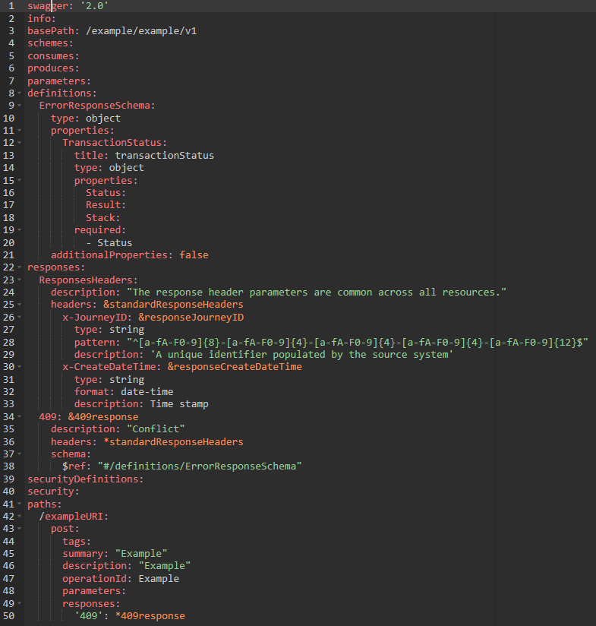
Appendix HTTP Responses – Categorisation Example
HTTP Code | Description | Type | Returned By |  | Swagger Presence | Defined at…
 |  |  | Service | Datapower
409 | Conflict | Error | ✓ | ✗ | Only when used by a service operation. | Swagger level
Included TransactionStatus
Response headers Included
Defined at swagger level
Only referenced at service level

Slide 13

Appendix HTTP Responses – Categorisation Example
HTTP Code | Description | Type | Returned By |  | Swagger Presence | Defined at…
 |  |  | Service | Datapower
400 | Bad Request | Error | ✓ | ✓ | Present in all swaggers. | Swagger level
404 | Not Found | Error | ✓ | ✓
500 | Internal Server Error | Error | ✓ | ✓
503 | Service Unavailable | Error | ✓ | ✓
504 | Gateway Timeout | Error | ✓ | ✓
Included TransactionStatus
Response headers Included
Defined at swagger level
Optionally referenced at service level

Slide 14
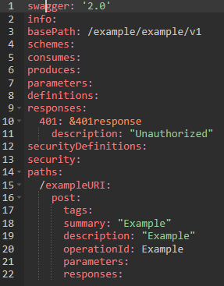
Appendix HTTP Responses – Categorisation Example
HTTP Code | Description | Type | Returned By |  | Swagger Presence | Defined at…
 |  |  | Service | Datapower
401 | Unauthorised | Error | ✗ | ✓ | Present in all swaggers. | Swagger level
403 | Forbidden | Error | ✗ | ✓
405 | Method Not Allowed | Error | ✗ | ✓
406 | Not Acceptable | Error | ✗ | ✓
429 | Too Many Requests | Error | ✗ | ✓
No response headers or TransactionStatus
Defined at swagger level
NOT referenced at service level

